Slide 1
Gradient Boosting
An ensemble learning technique

Slide 2

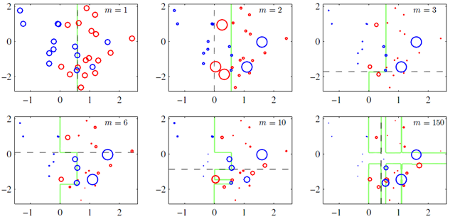
Origin Story
Born out of independent research from Schapire and Freund in the 1990
Iterative improvement of weak-learners can form a strong-learner
Weak-learner: 50% < classification rate < 99%
Boosting, in general, doesn’t manipulate the learners, but rather the weight of the observations after each iteration—to a point
Iteration specific coefficient increases weight dependent on the misclassification rate
Classification by weighted majority vote

Slide 3
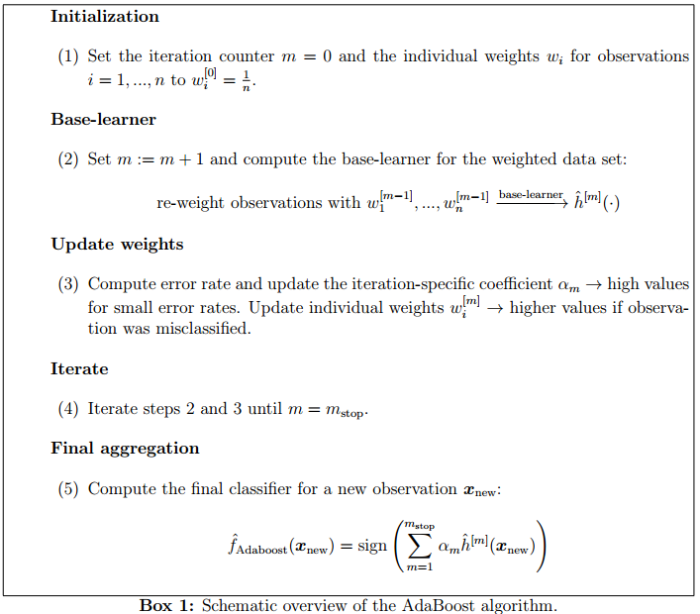
AdaBoost
Notes:
First adaptive boosting algorithm
->Iteratively adjusts both the weights for re-weighting the data and weights for the final aggregation
Bauer & Kohavi found that boosting can reduce both variation in base-learners prediction error
-> and average difference between predicted and true classes (bias)

Slide 4
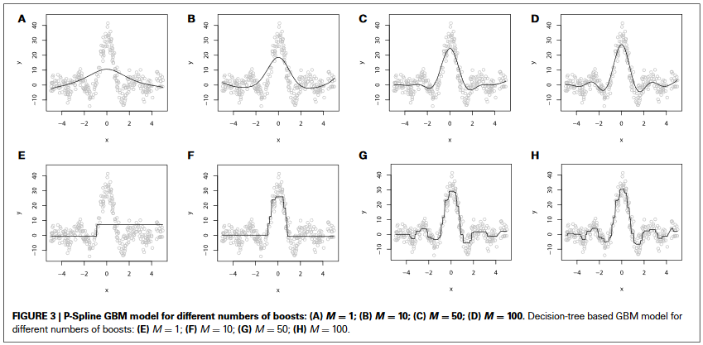
Overfitting
Notes:
Don’t find the best possible classifier for the training data
-> find best prediction rule for a set of new observations
Main proponent of overfitting in boosting algorithms is stopping iteration
-> large mstop lead to more complex models with higher variance and small bias
-> small mstop lead to sparser models with less variables, more shrinkage, and reduced variance
Select mstop not on best model of training data, but by the effect on test data
AdaBoost generalization error is bounded by the training error plus a term that increases with the number of boosting iterations and complexity of the base-learner
Occam’s Razor
Optimization is based less on correct classification, but rather the loss function

Slide 5
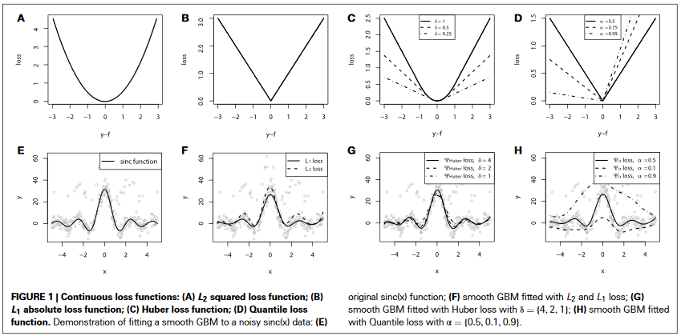
Overfitting
Notes:
Don’t find the best possible classifier for the training data
-> find best prediction rule for a set of new observations
Main proponent of overfitting in boosting algorithms is stopping iteration
AdaBoost generalization error is bounded by the training error plus a term that increases with the number of boosting iterations and complexity of the base-learner
Occam’s Razor
Optimization is based less on correct classification, but rather the loss function

Slide 6

Statistical Boosting
AdaBoost (an additive model) is a Black-box scheme
Statistical boosting quantifies relation between observed predictor and expectation of the response via interpretable function
$E\left(Y | X=x\right)=f(x)$
$f\left(x\right)= β_{0}+h_{1}\left(x_{1}\right)+…+h_{p}\left(x_{p}\right)$(Additive model)
Generalized Additive Model (GAM) :
$g\left(E\left(Y | X=x\right)\right)= β_{0}+\sum_{j=1}^{p}{h_{j}(x_{j})}$
Shape & size of the effect of the predictor can be visualized—thus, not a black box

Slide 7

Gradient Boosting
Optimizing the regression function:
$\hat{f}\left(∙\right)= {argmin \atop f\left(∙\right)}\left\{E_{Y,X}\left[ρ(Y, f\left(X\right))\right]\right\}$
Minimize empirical risk:
$\hat{f}\left(∙\right)= {argmin \atop f\left(∙\right)}\{\frac{1}{n}\sum_{i=1}^{n}{ρ\left(y_{i},f\left(x_{i}\right)\right\}}$
Fit the base-learner to negative gradient vector $u^{[m]}$ of the loss function $ρ(y, \hat{f}\left(x\right))$ evaluated at previous iteration $m−1$:
$u^{m}={(u_{i}^{[m]})}_{i=1,…n}={(−\frac{∂}{∂f}ρ(y_{i},f)|_{f={\hat{f}}^{\left[m−1\right]}(∙)})}_{i=1,…,n}$
Base-learner fitted to the errors of previous iteration:
$y−f{(∙)}^{[m−1]}$
Notes:
AdaBoost up-weights observations that were misclassified
Gradient boosting identifies difficult observations by large residuals computed by previous iterations

Slide 8
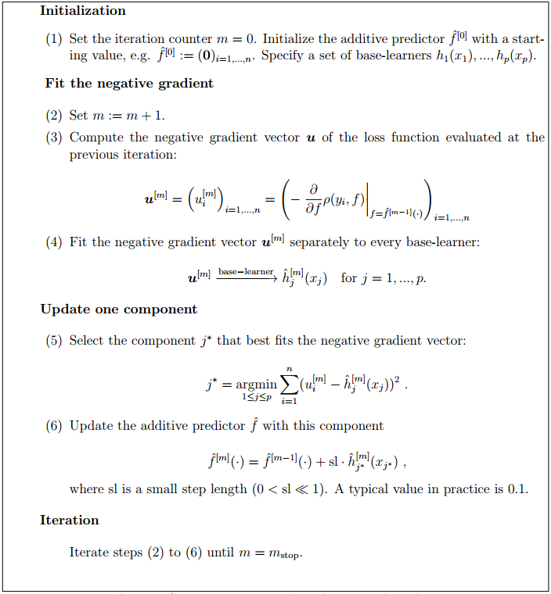
Gradient boosting
Notes:
Component-wise:
->different predictors are fitted by separate base-learners
Only a small amount of the fit of the best-performing base-learner is added to the current additive predictor
Each base-learner (typically) contains one predictor
->data-driven variable selection
--> Penalizes complex learners with small degrees of freedom

Slide 9
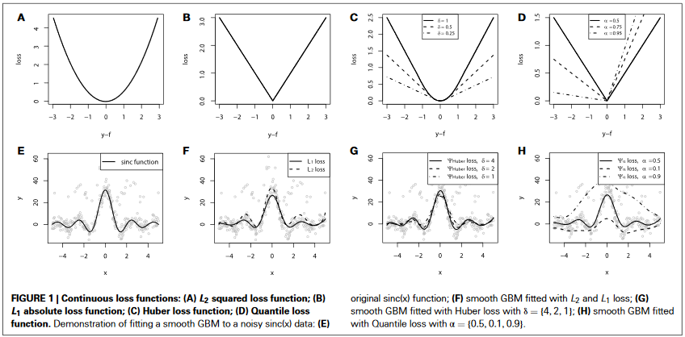
Gradient Boosting
Small step length and early stopping, GB introduces shrinkage of effect estimates
Leads to reduced variance of estimates
Notes:
Shrinkage of effect increases stability and accuracy of predictions
GB can optimize ANY loss function that is convex and differentiable

Slide 10
